Slide 1
Module 07: JavaFX Graphical User Interfaces
The new GUI tool for developing cross-platform rich GUI applications on desktop computers and on handheld devices

Slide 2
Objectives
To introduce Graphical user interface, GUI (§14.1).
To distinguish between JavaFX, Swing, and AWT (§14.2).
To understand the structure of a JavaFX application (§14.3).
To build JavaFX GUIs (§14.4).
To use the common properties for nodes (§14.6).
To use Color, Font, Image and ImageView classes (§14.7-9).
To understand layout (§14.10).
To develop the reusable GUI component ClockPane for displaying an analog clock (§14.12).

Slide 3
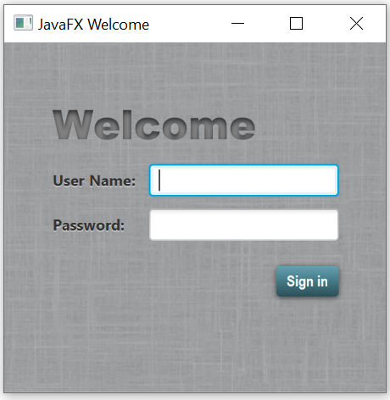
Graphical user interface (GUI)
A user-friendly mechanism for interacting with an app(GUI).
Graphical: not just text. windows, menus, buttons, etc.
User: a person using the program.
Interface: a way to interact with the program.
GUIs are Built from GUI components, controls or widgets.
Objects with which the user interacts via the mouse, the keyboard or another form of input.
Notes:
Providing different apps with consistent, intuitive user interface components gives users a sense of familiarity with a new app, so that they can learn it more quickly and use it more productively.

Slide 4
History of GUI in Java
Abstract Windows Toolkit (AWT )
Suit for developing simple graphical user interfaces.
Components depend on the target platform.
Prone to platform-specific bugs.
Swing
More robust, versatile, and flexible library.
Components depend less on the target platform.
Use less of the native GUI resources.
JavaFX
Much simpler to learn and use.
Used as a standalone or integrated with many IDEs which produces the same code regardless of the IDE.
Provides a multitouch support for touch-enabled devices.
Has a built-in 2D, 3D, animation support, video and audio playback.
Easy to be customized with CSS.
Better threading support.
Uses the GPU for hardware-accelerated rendering.
Notes:
Java’s original GUI library was the Abstract Window Toolkit (AWT).
Swing was added to the platform in Java SE 1.2. Until recently, Swing was the primary Java GUI technology. Swing will remain part of Java and is still widely used

Slide 5
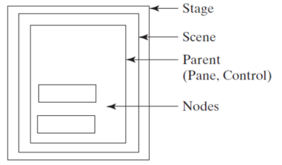
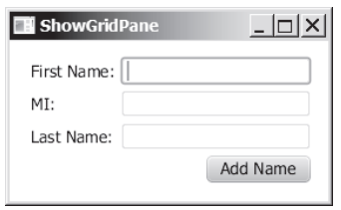
JavaFX App Window Structure: 1) Stage
The window in which a JavaFX app’s is displayed
An instance of class Stage (package javafx.stage)
The stage
Layout container to arrange the node
Scene graph of nodes
JavaFx components are nodes
Notes:
A JavaFX app window consists of several parts
The window in which a JavaFX app’s GUI is displayed is known as the stage and is an instance of class Stage (package javafx.stage)

Slide 6
JavaFX App Window Structure: 2) Scene
An instance of the class Scene (package javafx.scene).
The container for all content in a scene graph.
The stage contains one active scene that defines the GUI as a scene graph-tree data structure of an app’s visual elements.
Layout container to arrange the node
Scene graph of nodes
JavaFx components are nodes
Notes:
A JavaFX app window consists of several parts
The window in which a JavaFX app’s GUI is displayed is known as the stage and is an instance of class Stage (package javafx.stage)

Slide 7
JavaFX App Window Structure: 3) Layout Container
Nodes that have children.
Divide the scene into regions.
Arrange their children nodes in the scene.
Example: BorderPane, Vbox and GridPane.
The stage
Layout container to arrange the node
Scene graph of nodes
JavaFx components are nodes
Notes:
Nodes that have children are typically layout containers that arrange their child nodes in the scene. You’ll use two layout containers (VBox and GridPane)
The nodes arranged in a layout container are a combination of controls and, in more complex GUIs, possibly other layout containers.

Slide 8
JavaFX App Window Structure: 4) Nodes
Each visual element, control, displayed in the scene is a node.
GUI controls, shapes, images, video, text and more.
An instance of a subclass of Node, the base class for scene graph nodes defined in the package javafx.scene.
Node defines common attributes and behaviors for all nodes, opacity, effects and transforms.
The stage
Layout container to arrange the node
Scene graph of nodes
JavaFx components are nodes
Notes:
Each visual element in the scene graph is a node—an instance of a subclass of Node (package javafx.scene), which defines common attributes and behaviors for all nodes. With the exception of the first node in the scene graph—the root node—each node in the scene graph has one parent. Nodes can have transforms (e.g., moving, rotating and scaling), opacity (whether a node is transparent, partially transparent or opaque), effects (e.g., drop shadows, blurs, reflection and lighting) and more that we’ll introduce in later

Slide 9
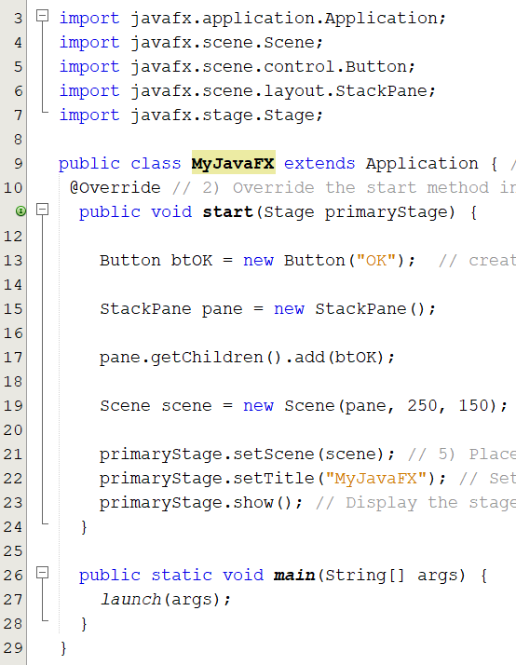
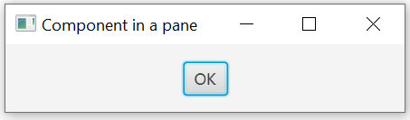
Simple JavaFX Program
1. JavaFx main class EXTENDS the Application class
2. Overrides the start method
The signature of the start method is
GUI Design Steps:
Create a node and set its properties.
Create a pane and set its properties.
Place the node in a pane.
Create a scene and place the pane in the scene.
Place the scene in the stage.
Show the stage
MyJavaFx is called the main class and is a subtype of Application.
Notes:
JavaFX program is defined in a class that extends javafx.application The main class overrides the start method defined in javafx.application.Application
start method normally places UI controls in a scene and displays the scene in a stage
creates a Button object and places it in a Scene object
A Scene object can be created using the constructor Scene(node, width, height). This constructor specifies the width and height of the scene and places the node in the scene

Slide 10
JavaFX App Structure
Every JavaFX program is defined in a class that extends javafx.application.Application
Overrides the start(Stage) method.
Contains Stage, Scene, Pane and Nodes.
A primary stage is automatically created when a JavaFX main class is launched.
You can have multiple stages displayed in a JavaFX program.
Stage stage = new Stage(); // Create a new stage
stage.setTitle("Second Stage"); // Set the stage title
// Set a scene with a button in the stage
stage.setScene( new Scene(new Button("New Stage"), 200, 250));
stage.show(); // Display the stage
MultipleStageDemo.java
Notes:
A JavaFX app window consists of several parts

Slide 11
Running JavaFX App
JVM either:
Run the main method, needed when you launch the app from an IDE with limited JavaFX support
Automatically invokes the static method launch to run the application if a main method is not defined.
Create an instance of the class using its no-arg constructor.
Invokes its start method
Which normally places UI controls in a scene and displays the scene in a stage.
A primary stage is automatically created when the application is launched.
main method
constructor
Start method
Notes:
The launch method (line 25) is a static method defined in the Application class for launching a stand-alone JavaFX application.
The launch method (line 25) is a static method defined in the Application class for launching a stand-alone JavaFX application.
The main method (lines 24–25) is not needed if you run the program from the command line.
It may be needed to launch a JavaFX program from an IDE with a limited JavaFX support.
When you run a JavaFX application without a main method, JVM automatically invokes the launch method to run the application.

Slide 12
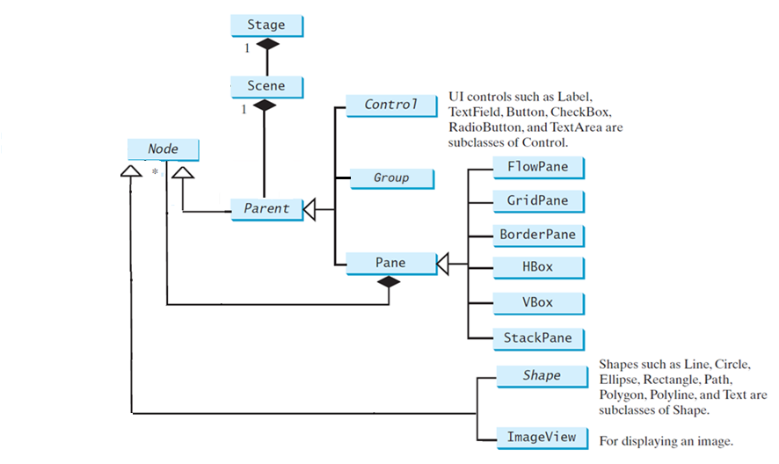
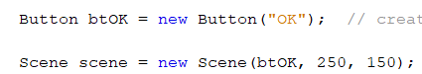
GUI Components
You can directly place an UI Control or a Pane into a scene
pane = new Pane();
pane.getChildren().add(image);
You cannot directly place a Shape or an ImageView into a scene.
Notes:
A shape refers to a text, line, circle, ellipse, rectangle, arc, polygon, polyline, and so on.
A UI control refers to a label, button, check box, radio button, text field, text area, and so on

Slide 13
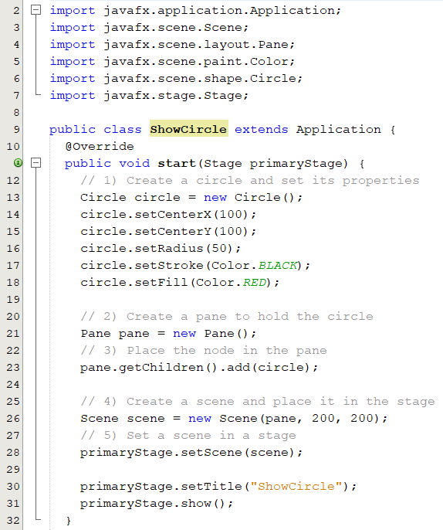
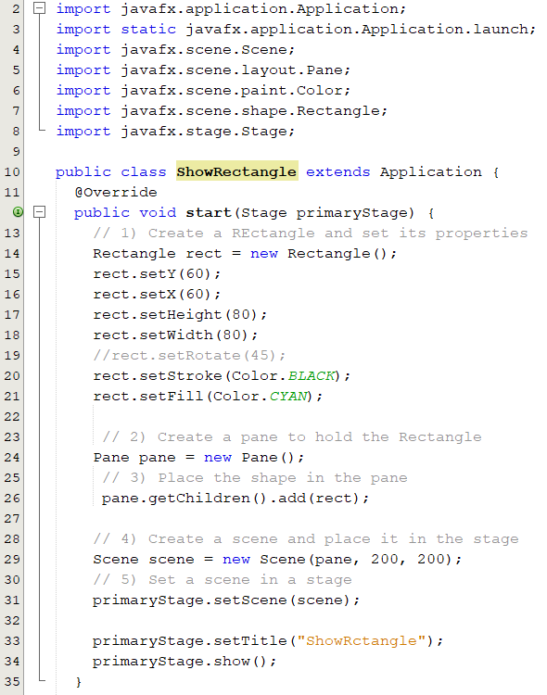
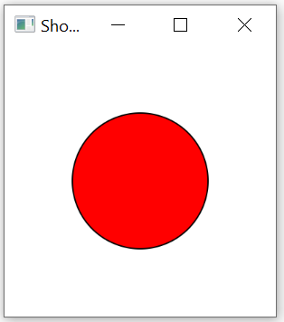
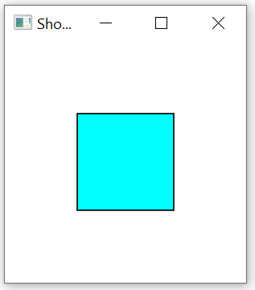
Display a Shape (1)
By default, the user can resize the stage. To prevent the user from resizing the stage, invoke stage.setResizable(false)
Notes:
The program creates a Circle (line 12) and sets its center at (100, 100) (lines 13 and 14), which is also the center for the scene, since the scene is created with the width and height of 200 (line 24). The radius of the circle is set to 50 (line 15). Note the measurement units for graphics in Java are all in pixels.
The stroke color (i.e., the color to draw the circle) is set to black (line 16). The fill color (i.e., the color to fill the circle) is set to white (line 17). You may set the color to null to specify that no color is set.

Slide 14
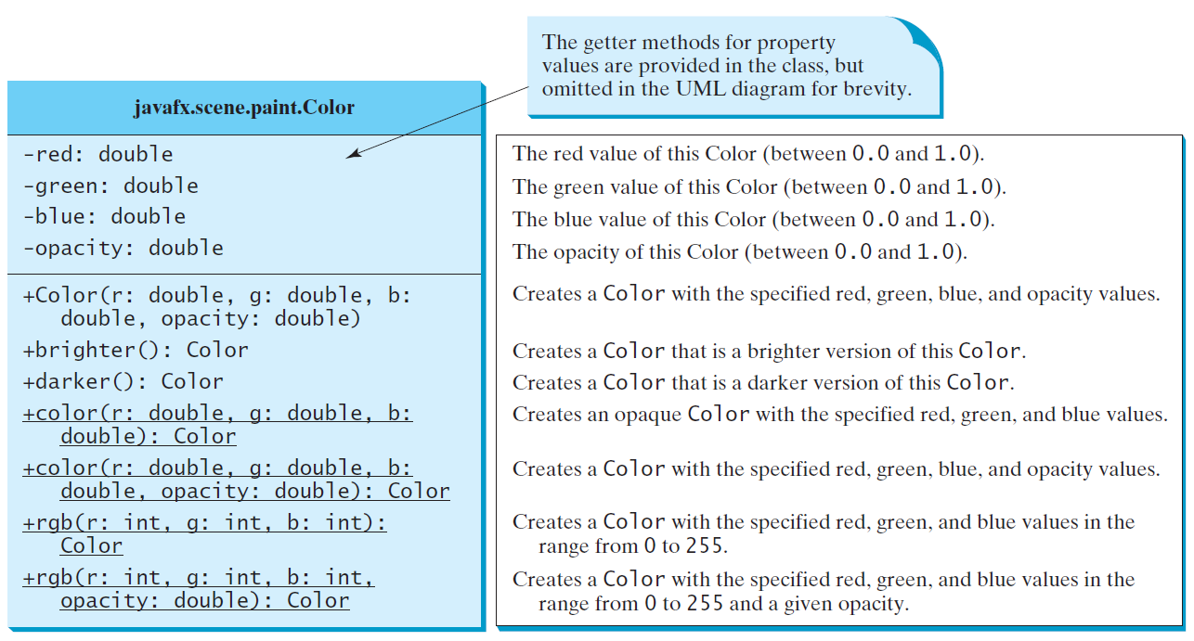
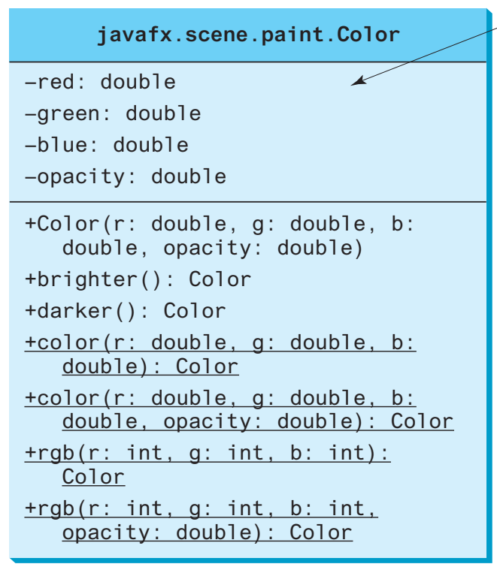
The Color Class
The Color class can be used to create colors.
The javafx.scene.paint.Color is a concrete subclass of the abstract class Paint which is used to encapsulate colors.
The Color class is immutable.
A color instance can be constructed using
The Color constructor:
new Color(double r, double g, double b, double opacity)
The static methods
Color.rgb(0,0,255)
Color.color(0.5, 0, 0)

Slide 15
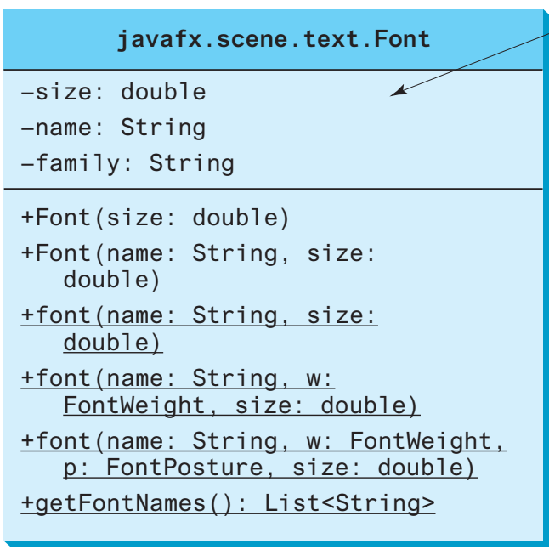
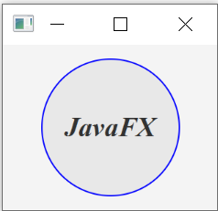
The Font Class
A Font describes font name, weight, and size.
The javafx.scene.text.Font class is used to create fonts.
A Font instance can be constructed using
The Font constructor:
new Font("SansSerif", 16);
The static methods
Font.font("Times New Roman", FontWeight.BOLD, FontPosture.ITALIC, 12);
Use Font.getFontNames() to return a list of strings for font names.
FontDemo.java

Slide 16
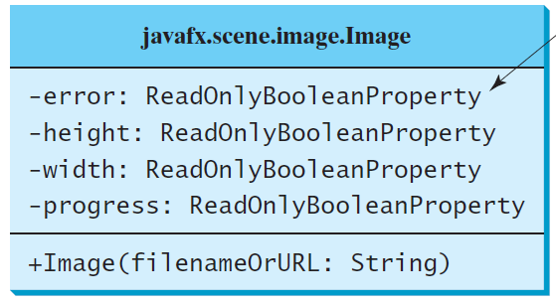
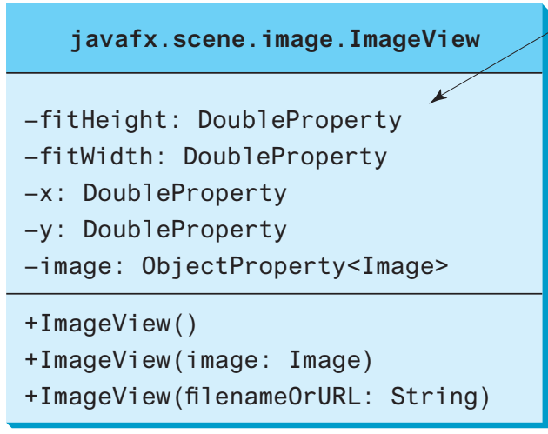
The Image and ImageView Classes
The javafx.scene.image.Image class represents a graphical image.
The ImageView class can be used to display an image.
You can load image from a specified filename or a URL.
new Image(fileName);
new Image(url);
An ImageView can be created from an Image object.
You can set an Image to multiple ImageView.
Image image = new Image("us.gif");
ImageView imageView = new ImageView(image);
ShowImage.java

Slide 17
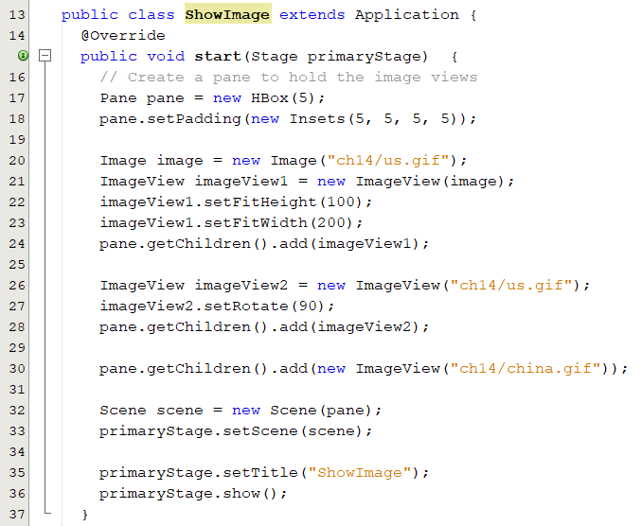
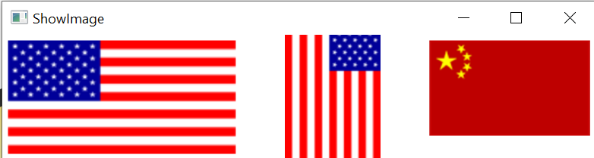
Example

Slide 18
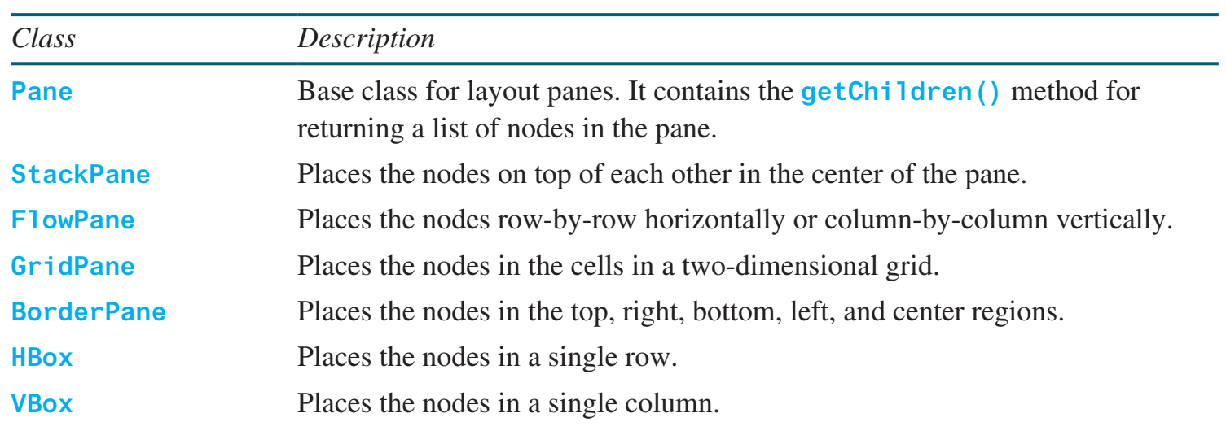
Layout Panes and Groups
Used to automatically laying out nodes in a desired location and size.
Create nodes
TextField textField = new TextField();
Instantiate the respective class of the required layout
HBox hbox = new HBox(); FlowPane root = new FlowPane();
Set the properties of the layout
hbox.setSpacing(10); root.setHgap(10);
Add all the created nodes to the layout
hbox.getChildren().add(textField);

Slide 19
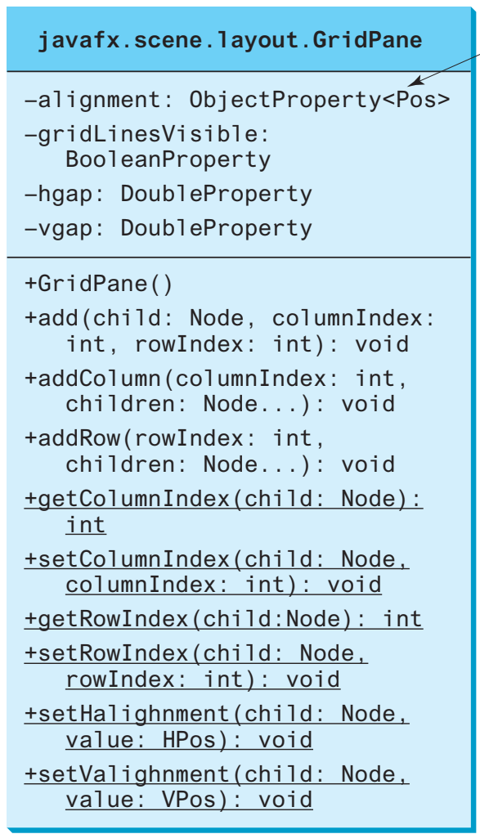
GridPane
A GridPane arranges nodes in a grid (matrix) formation.
The nodes are placed in the specified column and row indices
By default, the grid pane will resize rows and columns to the preferred sizes of its contents.

Slide 20
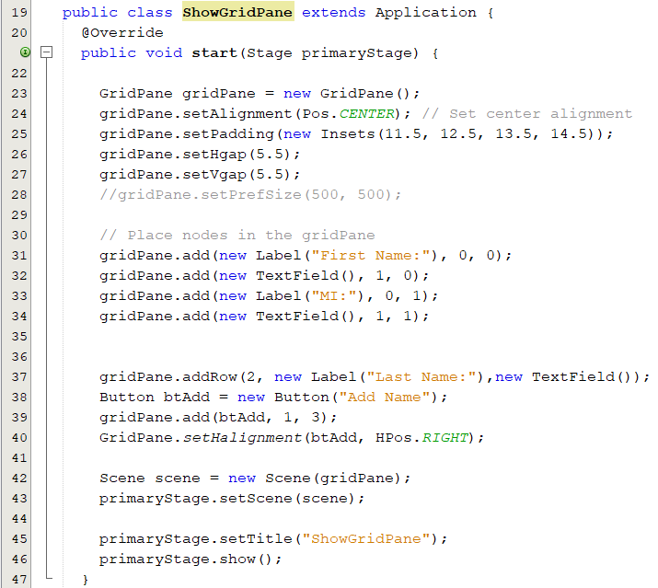
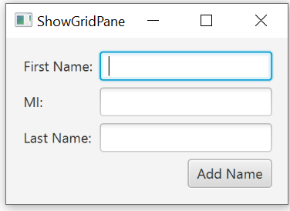
GridPane: Example 1
gridPane.add(new Label("First Name:"), 0, 0);
You can add a single component in a cell
gridPane.addRow(2,
new Label("Last Name:"),new TextField());
Placing the specified nodes sequentially in a given row of the gridpane. If the row already contains nodes the specified nodes will be appended to the row.

Slide 21
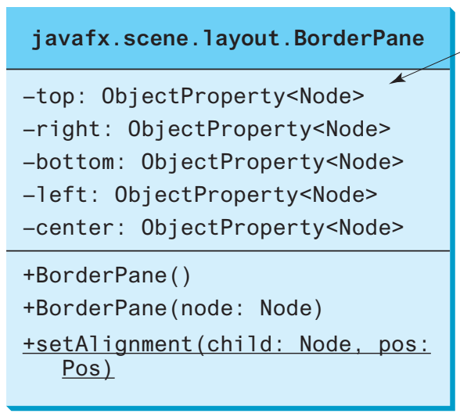
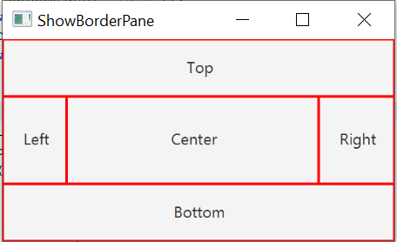
BorderPane
A BorderPane can place nodes in five regions.
Region | Top | Bottom | Left | Right | Center
Method | setTop(node) | setBottom(node) | setLeft(node) | setRight(node) | setCenter(node)

Slide 22
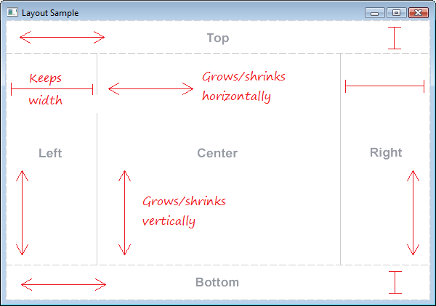
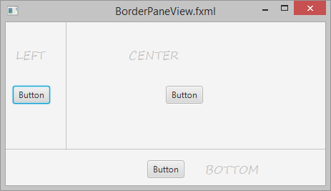
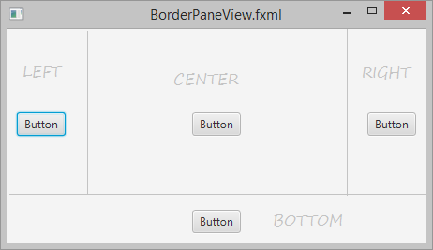
BorderPane
Top/Bottom area:
Can shrink/expand horizontally and keep the height unchanged.
Left/Right area:
Can shrink/expand vertically and keep the length unchanged.
Center area:
Can shrink/expand in both directions.
If a certain area does not contain components, the area will be occupied by other areas.

Slide 23
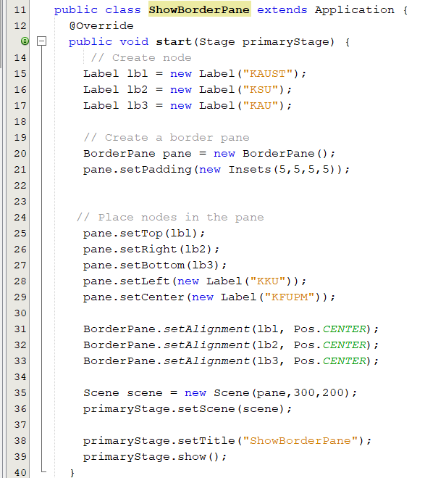
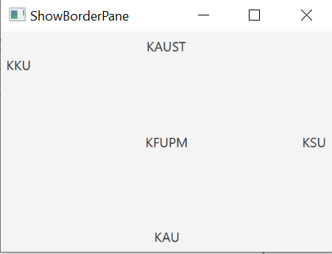
BorderPane: Example

Slide 24
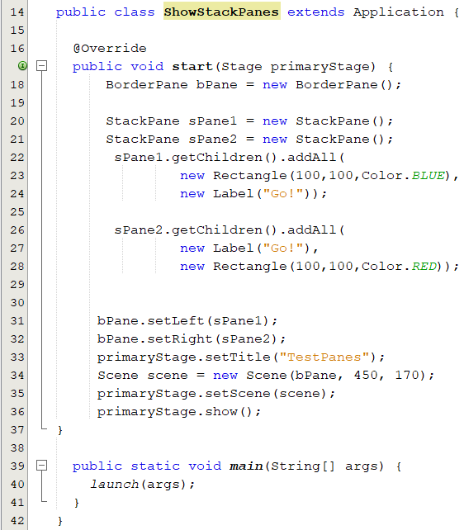
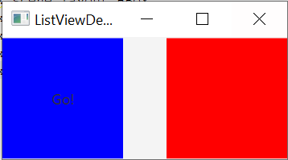
StackPane
StackPane lays out its children in a back-to-front stack.
The z-order of the children is defined by the order of the children list with the 0th child being the bottom and last child on top
Label under the rectangle (stacked)

Slide 25
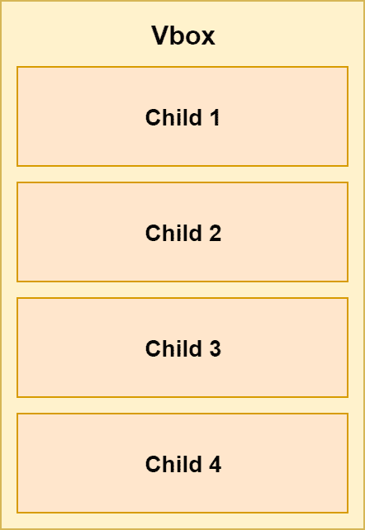
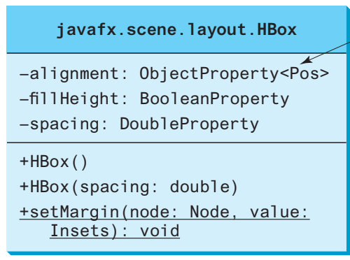
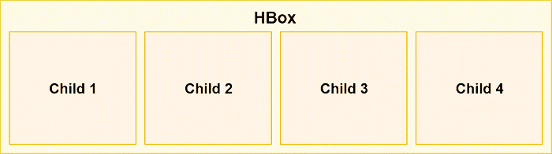
HBox and VBox
1. HBox
lays out its children in a single horizontal row.
2. VBox
lays out its children in a single vertical column.

Slide 26
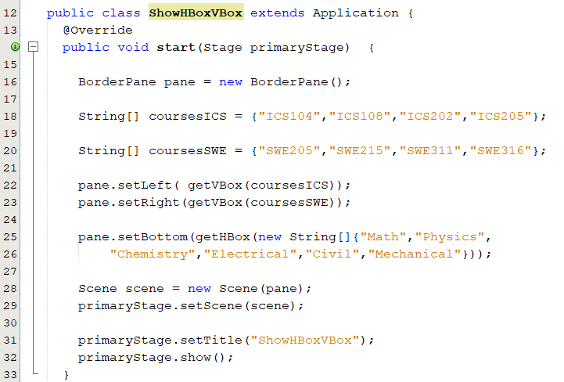
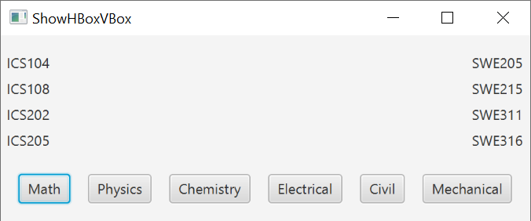
HBox and Vbox: Example

Slide 27
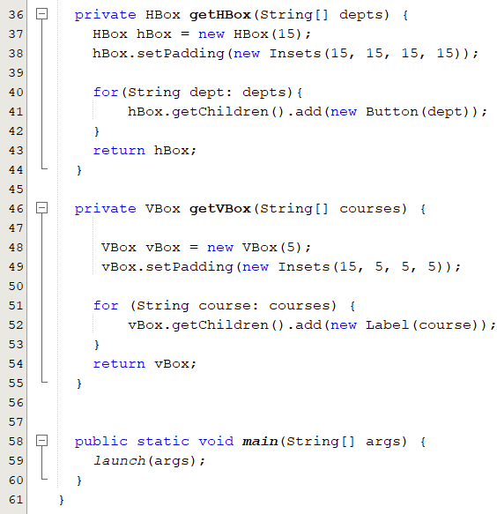
HBox and Vbox: Example

Slide 28
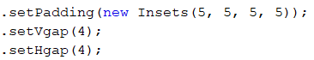
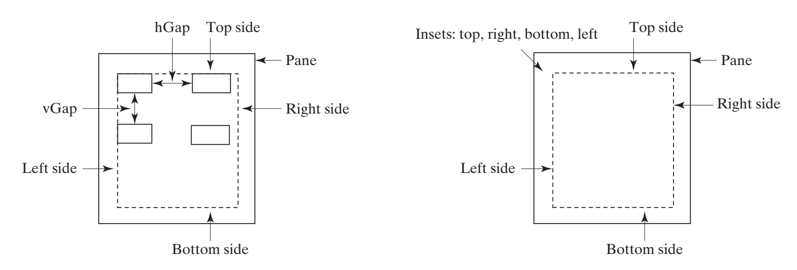
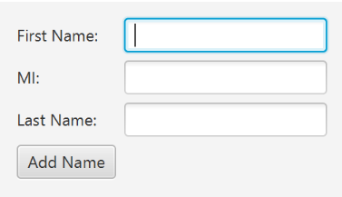
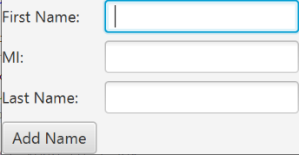
Padding property:
An Insets object specifies the size of the border of a pane

Slide 29
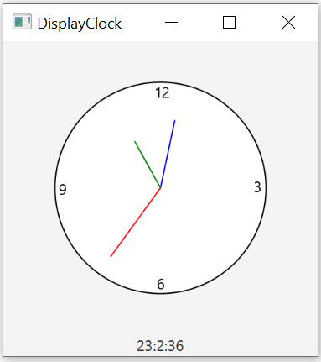
Case Study: The ClockPane Class
This case study develops a class that displays a clock on a pane.

Slide 30
Event-Driven Programming

Slide 31
Objectives
To introduce event-driven programming (§15.1).
To describe events, event sources, and event classes (§15.2).
To define handler classes, register handler objects with the source object, and write the code to handle events (§15.3).
To define handler classes using inner classes (§15.4).
To define handler classes using anonymous inner classes (§15.5).
To simplify event handling using lambda expressions (§15.6).
To develop a GUI application for a loan calculator (§15.7).
To write programs to deal with MouseEvents (§15.8).
To write programs to deal with KeyEvents (§15.9).
To use the Animation, PathTransition, FadeTransition, and Timeline classes to develop animations (§15.11).
To develop an animation for simulating a bouncing ball (§15.12).

Slide 32
Procedural vs. Event-Driven Programming
A programming style that uses an event-and-response approach to programming.
Procedural Programming | Event-Driven Programming
List of statements executed in order | Objects that can fire events and objects that react to events.
Next thing to happen is next thing in the list. | Next thing to happen depends on next event.
Program performed by the computer. ( interaction is minimum) | Program is an interaction between user and computer

Slide 33
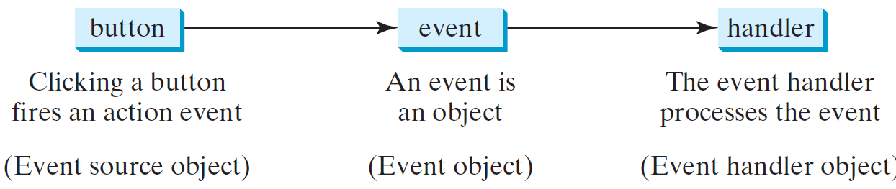
Event-Driven Programming
When the user interacts with a control, such as clicking a Button or typing text into a TextField, the control generates an event.
Programs can respond to these events - event handling- to specify what should happen when each user interaction occurs.
Clicking a mouse
Dragging the mouse
Pressing a key on the keyboard
Clicking the close-window button on a window
Notes:
The object that fires the event is often a GUI component, such as a button. The button fires the event in response to being clicked.
The handler object performs some action in response to the event.
For example, the handler might place a message on the screen in response to a particular button being clicked.
A given component may have any number of handlers, from zero to several handlers.
Each handler might respond to a different kind of event, or multiple handlers might respond to the same events.
The event handler object performs some action in response to the event an event often represents some action such as clicking a mouse, dragging the mouse, pressing a key on the keyboard, clicking the close-window button on a window.
A handler object has methods that specify what will happen when events of various kinds are received by the handler.
These methods that handle events are called event handlers. You the programmer will define (or redefine) these event-handler methods. The relationship between an event-firing object, such as a button, and its event-handling listener is shown diagrammatically

Slide 34
Events and Event Sources
A type of signal to the program that something has happened.
Generated by external user actions such as mouse movements, mouse clicks, or keystrokes.
An event in JavaFX is an object of the javafx.event.Event class.
Event object properties:
Identify the source object of an event using the getSource() instance method in the EventObject class

Slide 35
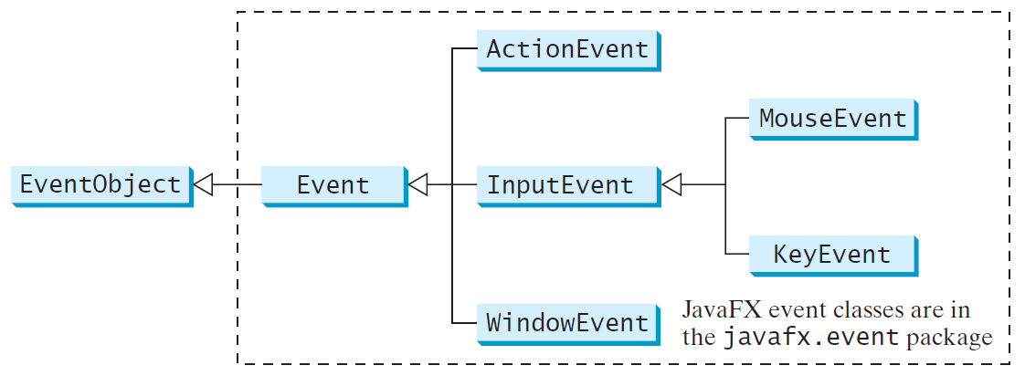
Events and Event Sources
java.util.EventObject is the root class of the Java event classes.
javafx.event.Event is the root class of the JavaFX event classes.
The subclasses of EventObject deal with specific types of events, such as action events, window events, mouse events, and key events.
Notes:
The subclasses of EventObject deal with specific types of events, such as action events, window events, mouse events, and key events.

Slide 36
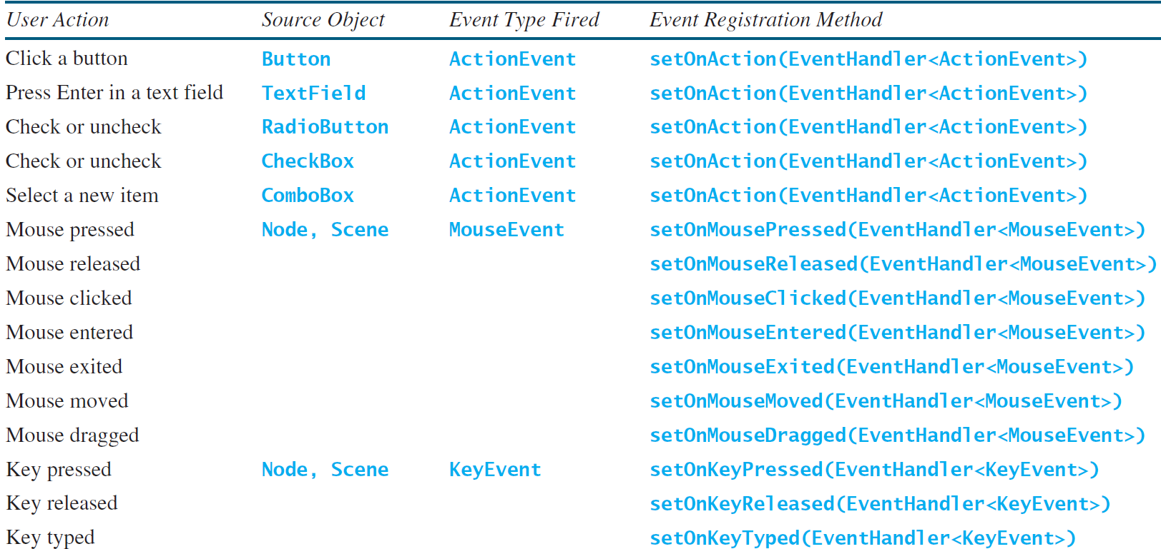
Selected User Events and Handlers
The subclasses of EventObject deal with special types of events, such as action events, window events, mouse events, and key events.
Notes:
For example, when clicking a button, the button creates and fires an ActionEvent, as indicated in the first line of this table. Here, the button is an event source object, and an ActionEvent is the event object fired by the source object, as shown in Figure 15.3

Slide 37
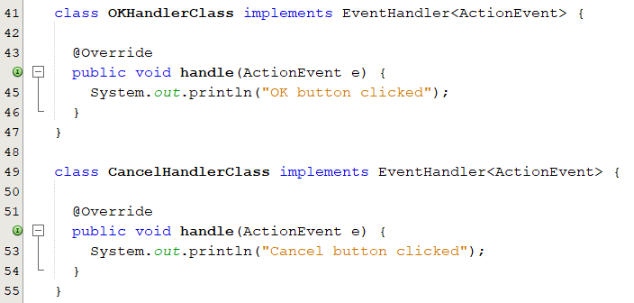
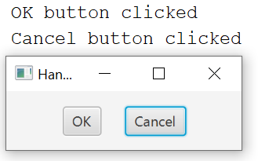
The Event Handler Object
An event handler is an object that responds to a user interaction.
Must be an instance of the EventHandler<T extends Event> interface.
Must override the handle(ActionEvent e) method to respond to the event.
Notes:
Two handler classes are defined in lines 32–44. Each handler class implements EventHandler<ActionEvent> to process ActionEvent.
The object handler1 is an instance of OKHandlerClass (line 18), which is registered with the button btOK.
When the OK button is clicked, the handle(ActionEvent) method (line 34) in OKHandlerClass is invoked to process the event

Slide 38
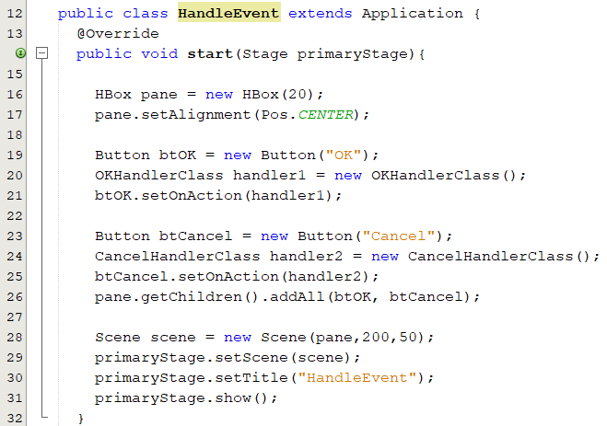
The Event Handler Object
Must be registered with the event source object.
source.setOnAction(handler), setOnMousePressed(handler), setOnKeyPressed(handler)
Notes:
Two handler classes are defined in lines 32–44. Each handler class implements EventHandler<ActionEvent> to process ActionEvent.
The object handler1 is an instance of OKHandlerClass (line 18), which is registered with the button btOK.
When the OK button is clicked, the handle(ActionEvent) method (line 34) in OKHandlerClass is invoked to process the event

Slide 39
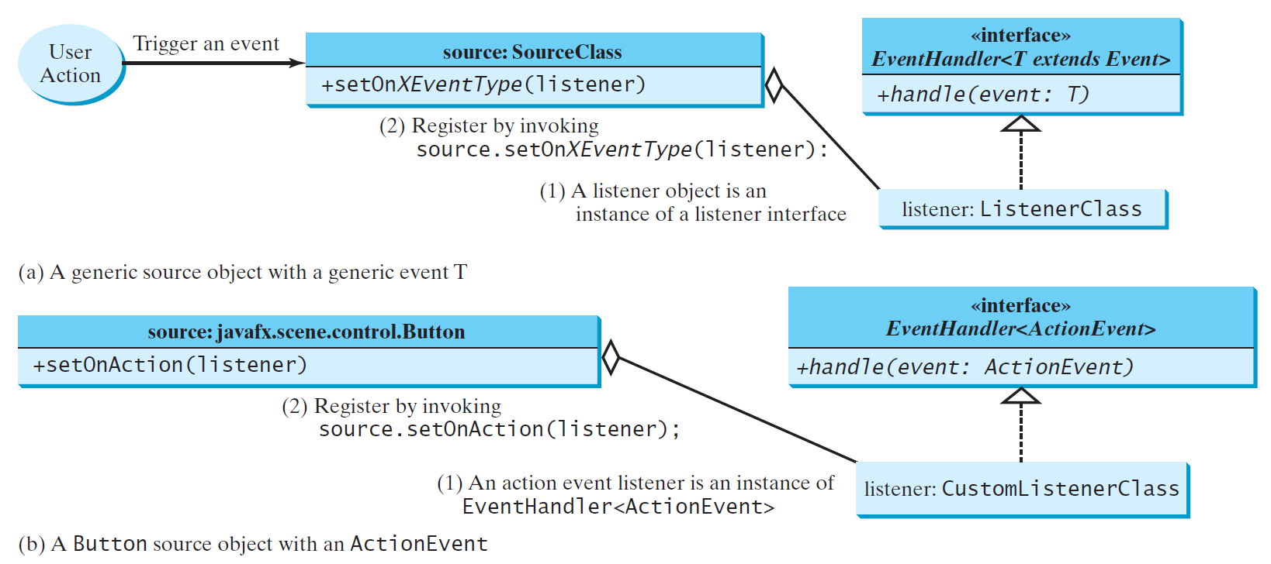
The Delegation Model
A source object fires an event
Event handler handles the event
Button btOK = new Button("OK");
OKHandlerClass handler = new OKHandlerClass();
btOK.setOnAction(handler);
Notes:
he handler object must be an instance of the corresponding event–handler interface to ensure the handler has the correct method for processing the event. JavaFX defines a unified handler interface EventHandler<T extends Event> for an event T. The handler interface contains the handle(T e) method for processing the event. For example, the handler interface for ActionEvent is EventHandler<ActionEvent>; each handler for ActionEvent should oveeride the handle(ActionEvent e) method for processing an ActionEvent. 2. The handler object must be registered by the source object. Registration methods depend on the event type. For ActionEvent, the method is setOnAction. For a mouse-pressed event, the method is setOnMousePressed. For a key-pressed event, the method is setOnKeyPressed

Slide 40


Example 1: Without Handler
Create the user interface
Create nodes and set their properties
Create a pane and set its properties
Place the node in the pane
Create a scene and place the pane in the scene
Set the scene in a stage
Process the event
1. Create the handler
class ButtonHandler implements
EventHandler<ActionEvent>
2. Register the handler
setOnAction()

Slide 41



Example 2: With Handler

Slide 42

Handlers

Slide 43



Example 3: Moving a Circle

Slide 44

Example 4: Display Images
Analyze the application:
Create the user interface. What do we need?
Process the event
How many nodes do we need?
What are their types and properties?
Create the user interface
Create nodes and set their properties
Create a pane and set its properties
Place the node in a pane
Create a scene and place the pane in the scene
set a scene in a stage
Which pane type do we need to use?
How do we place nodes in the pane?

Slide 45


Example 4: Display Images
Create the user interface
Create nodes and set their properties
Create a pane and set its properties
Place the node in a pane
Create a scene and place the pane in the scene
set a scene in a stage
Process the event
Create the handler
class ButtonHandler implements
EventHandler<ActionEvent>
Register the handler
setOnAction()

Slide 46
Handlers Implementation
A class defined within the scope of another class.
Can be defined with public, protected, private and default visibility modifier.
Can access the members of its outer class, even private members,
Can be defined as static.
Compiled into a file named OuterClass$InnerClass.class.
Inner Classes
A special kind of inner classes without a name.
We define a class and create an object in one step.
Must implement all the abstract methods in the superclass or in the interface.
Generally, they are used whenever you need to extend a superclass or implement an interface, but it cannot have an explicit extends or implements clause.
Anonymous Classes
Can be viewed as an anonymous class with a concise syntax.
Lambda Expressions

Slide 47

Anonymous Classes
The anonymous class expression consists of the following:
The new operator
The name of an interface to implement or a class to extend
Parentheses that contain the arguments to a constructor
A body, in which method declarations are allowed but statements are not.
new SuperClassName/InterfaceName() {
// Implement or override methods in superclass or interface
// Other methods if necessary
}

Slide 48



Lambda Expressions
A new feature in Java 8.
Lambda expressions can be viewed as an anonymous method with a concise syntax.
Syntax
Notes:
Lambda expression is a new feature in Java 8. Lambda expressions can be viewed as an anonymous method with a concise syntax. For example, the following code in (a) can be greatly simplified using a lambda expression in (b) in three lines.
The basic syntax for a lambda expression is either
(type1 param1, type2 param2, ...) -> expression
or
(type1 param1, type2 param2, ...) -> { statements; }
The data type for a parameter may be explicitly declared or implicitly inferred by the compiler. The parentheses can be omitted if there is only one parameter without an explicit data type.

Slide 49

Lambda Expression Processing
Compiler treats a lambda expression as if it is an object created from an anonymous class and processes a lambda expression in three step:
Determines object type
Determines parameter types
Determine the code for processing the event
The data type for a parameter may be explicitly declared or implicitly inferred by the compiler. The parentheses can be omitted if there is only one parameter without an explicit data type.
Notes:
Step 1: The compiler recognizes that the object must be an instance of EventHandler <ActionEvent>, since the expression is an argument of the setOnAction method as shown in the following figure:
Step 2: Since the EventHandler interface defines the handle method with a parameter of the ActionEvent type, the compiler recognizes that e is a parameter of the ActionEvent type.
Step 3: The compiler recognizes that the code for processing e is the statements in the body of the handle method.
The EventHandler interface contains just one method named handle. The statements in the lambda expression are all for that method. If it contains multiple methods, the compiler will not be able to compile the lambda expression

Slide 50



Handlers Example
1
2
3
Using lambda expression
Using Inner class
Using anonymous inner-class

Slide 51

Case Study: Loan Calculator
Analyze the application:
Create the user interface.
Process the event
Create nodes and set their properties
Create a pane and set its properties
Place the nodes in the pane
Create a scene and place the pane in the scene
Place the scene in a stage
Which event type do we need to use?
ActionEvent, WindowEvent, MouseEvent, KeyEvent
Create the handler
Inner class, anonymous class, Lambda expression
Register the handler
setOnAction(); setOnMouseClicked(); setOnKeyPressed();

Slide 52


Loan Calculator:
Notes:
The user interface is created in the start method (lines 22–46). The button is the source of the event. A handler is created and registered with the button (line 49). The button handler invokes the calculateLoanPayment() method to get the interest rate (line 60), number of years (line 62), and loan amount (line 64). Invoking tfAnnualInterestRate.getText() returns the string text in the tfAnnualInterestRate text field. The Loan class is used for computing the loan payments. This class was introduced in Listing 10.2, Loan.java. Invoking loan.getMonthlyPayment() returns the monthly payment for the loan (line 71). The String.format method, introduced in Section 10.10.7, is used to format a number into a desirable format and returns it as a string (lines 70 and 72). Invoking the setText method on a text field sets a string value in the text field

Slide 53


Mouse Events
Fired whenever a mouse button is pressed, released, clicked, moved, or dragged on a node or a scene.
Mouse (pointer's) location is available relative to:
Node, scene and screen.
Four constants are defined in MouseButton: RIMARY, SECONDARY, MIDDLE, and NONE
Notes:
When mouse event occurs, the top-most node under cursor is picked and the event is delivered to I
The MouseEvent object captures the event, such as the number of clicks associated with it, the location (the x- and y-coordinates) of the mouse, or which mouse button was pressed.
The mouse (pointer's) location is available relative to several coordinate systems:
x,y - relative to the origin of the MouseEvent's node,
sceneX,sceneY - relative to to the origin of the Scene that contains the node,
screenX,screenY - relative to origin of the screen that contains the mouse pointer.

Slide 54
Mouse Events
Mouse Event | Description | Registrar Method
MOUSE_CLICKED | occurs when mouse button has been clicked (pressed and released on the same node). | setOnMouseClicked()
MOUSE_ENTERED | occurs when mouse enters a node. | setOnMouseEntered()
MOUSE_EXITED | occurs when mouse exits a node. | setOnMouseExited()
MOUSE_MOVED | occurs when mouse moves within a node and no buttons are pressed. | setOnMouseMoved()
MOUSE_PRESSED | occurs when mouse button is pressed | setOnMousePressed()
MOUSE_RELEASED | occurs when mouse button is released. | setOnMouseReleased()
MOUSE_DRAGGED | occurs when mouse moves with a pressed button. | setOnMouseDragged()
MOUSE_ENTERED and MOUSE_EXITED are delivered only to the entered/exited node.

Slide 55


Mouse Events: Example
Moving a text by dragging the mouse.
GUI Requirement
Pane
Text
Event handling requirement
Handler type
Processing:
Change the X and Y properties to the mouse x-coordinate and y-coordinate respectively.

Slide 56

Key Events
Fired whenever a key is pressed, released, or typed on a node or a scene.
Enable the use of the keys to control and perform actions, or get input from the keyboard.
Notes:
The KeyEvent object describes the nature of the event (namely, that a key has been pressed, released, or typed) and the value of the key.
The key pressed handler is invoked when a key is pressed, the key released handler is invoked when a key is released, and the key typed handler is invoked when a Unicode character is entered.

Slide 57

Key Event Types
Mouse Event | Description | Registrar Method
KEY_PRESSED | occurs when a key has been pressed. | setOnKeyPressed()
KEY_RELEASED | occurs when a key has been released | setOnKeyReleased()
KEY_TYPED | occurs when a character-generating key was typed (pressed and released). | setOnKeyTyped()
The KeyCode Constants
"Key Typed" events
No key typed events are generated for keys that don't generate Unicode characters.
Action keys: F1, Enter
Modifier keys: Alt, Shift
KeyEventDemo.java

Slide 58



Example: Control Circle with Mouse and Key

Slide 59
Animations

Slide 60

Animation
JavaFX provides the Animation class with the core functionality for all animations.
An animation can run in a loop by setting cycleCount.
An Animation with indefinite duration (a cycleCount of INDEFINITE) runs repeatedly until the stop() method is explicitly called
To make an animation run back and forth while looping, set the autoReverse -flag.

Slide 61

PathTransition
Creates a path animation that spans its duration.
The translation along the path is done by updating the translateX and translateY variables of the node.
The animated path is defined by the outline of a shape.
Notes:
This Transition creates a path animation that spans its duration. The translation along the path is done by updating the translateX and translateY variables of the node, and the rotate variable will get updated if orientation is set to OrientationType.ORTHOGONAL_TO_TANGENT, at regular interval. The animated path is defined by the outline of a shape.

Slide 62


PathTransition: Example 1
Create a PathTransition objet.
Set the duration.
Set the node, the object to be moved.
Set the path, the route the node will pass through.
Set cycle count.
Set orientation.

Slide 63


Timeline: Show/Hide a Text
Timeline
+autoReverse +cycleCount
Timeline() Timeline(KeyFrame... keyFrames) +play() +stop() +pause()

Slide 64



Example: ClockPane (1/3)

Slide 65




Example: ClockPane (2/3)

Slide 66

Example: ClockPane (3/3)

Slide 67




Case Study: Bouncing Ball (1/3)

Slide 68


Bouncing Ball (2/3)

Slide 69

Bouncing Ball (3/3)

Slide 70
JavaFX UI Controls and Multimedia

Slide 71
Outline
To create graphical user interfaces with various controls (§§16.2–16.11).
To use Label class (§16.2).
To use Button class (§16.3).
To use CheckBox class (§16.4).
To use RadioButton (§16.5).
To useTextField class and password using the PasswordField class (§16.6).
To useTextArea class (§16.7).
To use ComboBox calss(§16.8).
To use ListView class(§16.9).
To develop a tic-tac-toe game (§16.12).
To view and play video and audio using the Media, MediaPlayer, and MediaView (§16.13).
To develop a case study for showing the national flag and play anthem (§16.14).

Slide 72

JavaFX UI Controls
Every user interface has the following:
UI elements: core visual elements which the user eventually sees and interacts with.
Layouts: to organize other components on the screen and provide a final look and feel to the GU.
Behavior: Events which occur when the user interacts with UI elements.
Classes to construct UI controls reside in the javafx.scene.control package of the API.

Slide 73


Label (1/2)
A label is a display area for a short text, a node, or both.
It is often used to label other controls (usually text fields).
Display a text
Add a node
Apply visual effect
Label label1 = new Label();
Label label2 = new Label("Search");
new Label("Search", new ImageView(image));
Notes:
Let me explain how to use the Label class to display a text element. Learn how to wrap a text element to fit the specific space, add a graphical image, or apply visual effects.
The JavaFX API provides three constructors of the Label class for creating labels in your

Slide 74
Label (2/2)
Adding an Icon and Text to a Label
specify the text caption for the label
specify the graphical icon
Setting label properties
Specify the color of the text
Set the gap between label and graphics
Specify the positioning of the graphic relative to the text
Set the font
Wrap Text
Apply transformations effects
Apply magnify effects
setText(String text)
setGraphic(Node graphic)
setTextFill(Color.web("#1176b3"));
setGraphicTextGap(10)
setContentDisplay(ContentDisplay.TOP);
setFont(new Font("Arial", 30));
setWrapText(true);
setRotate(270);
setTranslateY(50);
setScaleX(1.5);
setScaleY(1.5);
Notes:
To provide a font text size other than the default for your label use the setFont method of the Labeled class.
When you create a label, sometimes you must fit it within a space that is smaller than you need to render. To break up (wrap) the text so that is can fit into the layout area, set the true value for the setWrapText method
Although a label is static content and cannot be edited, you can apply visual effects or transformations to it.
Rotation and translation are typical transformations available in the JavaFX API. Additionally, you can set up an effect that zooms (magnifies) the label when a user hovers the mouse cursor over it.

Slide 75



Label: Example
Notes:
If the text of the label exceeds the bounds of the label, then the last three characters which can be displayed will be "...". If the label is too short to even display that, then only as many "." as possible will be shown.

Slide 76

Button (1/2)
JavaFX provides regular buttons, toggle buttons, check box buttons, and radio buttons. The common features of these buttons are defined in ButtonBase and Labeled classes.
A button is a control that triggers an action event when clicked
Button btn = new Button();
Button btn = new Button(“Search");
Button button3 = new Button ( “OK", new ImageView(imageOk)
);
Setting properties
Specify the text caption for the button
Specify the graphical icon
Disable the button
Set the default button
setText(String text)
setGraphic(Node graphic)
setDisable(true);
A default Button is the button that receives a keyboard VK_ENTER press, if no other node in the scene consumes it
setDefaultButton(true);
Notes:
JavaFX button control is represented by javafx.scene.control.Button class. A button is a component that can control the behavior of the Application. An event is generated whenever the button gets clicked.
The Button class is an extension of the Labeled class. It can display text, an image, or both
JavaFX provides regular buttons, toggle buttons, check box buttons, and radio buttons. The common features of these buttons are defined in ButtonBase and Labeled classes.

Slide 77


Button (2/2)
Analyze the GUI.

Slide 78

Check Box (1/3)
A CheckBox is used for the user to make a selection.
It inherits all the properties from ButtonBase and Labeled.
CheckBox cb1 = new CheckBox();
CheckBox cb2 = new CheckBox(“agree")
Specify the text caption for the checkbox
Set the checkbox
Read the selected state of a CheckBox
setText(String text)
setSelected(true)
isSelected()

Slide 79



Check Box (2/3): Example 1

Slide 80




Check Box (3/3): Example 2
Analyze the GUI

Slide 81

Radio Button (1/4)
Enable you to choose a single item from a group of choices.
Can be either selected or deselected
RadioButton rb2 = new RadioButton(“Windows");
RadioButton rb1 = new RadioButton();
Setting properties
Specify the text caption for the Radio Button
Set the Radio Button
Read the selected state of a Radio Button
Specify a graphics
setText(String text);
setSelected(true);
isSelected();
setGraphic(new ImageView(image));
Notes:
A radio button control can be either selected or deselected. Typically radio buttons are combined into a group where only one button at a time can be selected. This behavior distinguishes them from toggle buttons, because all toggle buttons in a group can be in a deselected state.

Slide 82
Radio Button (2/4)
Radio buttons are typically used in a group to present several mutually exclusive options.
ToggleGroup object is used to group radio buttons
Ensure that only one of the radio buttons can be selected at a time.
Creating a Group of Radio Buttons
ToggleGroup group = new ToggleGroup();
Assigning a Radio Button to a Group of Radio Buttons
setToggleGroup(group);
Notes:
ToggleGroup object provides references to all radio buttons that are associated with it and manages them so that only one of the radio buttons can be selected at a time.

Slide 83



Radio Button (3/4): Example 1
Analyze the GUI.

Slide 84




Radio Button (4/4): Example 2
Analyze the GUI

Slide 85

Text Field (1/2)
A text field can be used to enter or display a string.
TextField textField = new TextField ();
TextField textField = new TextField (“ICS1018”);
Set the prompt text to display in the text
Obtain/set the value of a text field
Set the size of the text field
Specify a graphics
Transfer the currently selected range in the text to the clipboard, leaving/removing the current selection.
setPromptText("Enter your name");
getText(); setText();
setPrefColumnCount(int value);
setGraphic(new ImageView(image));
copy(); cut(); paste();

Slide 86


Text Field (2/2)

Slide 87

Text Area (1/2)
A TextArea enables the user to enter multiple lines of text.
TextArea textArea = new TextArea();
TextArea textArea = new TextArea(String text);
Indicates whether text area can be edited by the user.
setEditable(boolean value);
Notes:
Text input component that allows a user to enter multiple lines of plain text

Slide 88



Text Area (2/2)

Slide 89

Combo Box(1/3)
A combo box contains a list of items from which the user can choose.
Notes:
A combo box is a typical element of a user interface that enables users to choose one of several options. A combo box is helpful when the number of items to show exceeds some limit, because it can add scrolling to the drop down list, unlike a choice box. If the number of items does not exceed a certain limit, developers can decide whether a combo box or a choice box better suits their needs.

Slide 90
Combo Box(2/3)
Creating a Combo Box
Define items as an observable list.
Use an empty constructor and call the getItems().addAll
Setting/gettting properties
specify the item selected in the combo box.
Get the value/index of the selected item.
Restrict the number of visible rows.
Specify whether the ComboBox allows for user input
ComboBox<String> cbo = new ComboBox<>();
cbo.getItems().addAll("ICS","Math","Physics");
ComboBox<String> cbo = new ComboBox<>();
for(int i=30; i>0; i--)
cbo.getItems().add(i);
cbo.setValue("Math");
String value = cbo.getValue();
cbo.getSelectionModel().getSelectedIndex()
setVisibleRowCount(3);
setEditable(boolean value);
Notes:
When creating a combo box, you must instantiate the ComboBox class and define the items as an observable list, just like other UI controls such as ChoiceBox, ListView, and TableView. Example 14-1 sets the items within a constructor.
You can use the setValue method to specify the item selected in the combo box
Similarly, you can obtain the value of the selected item by calling the getValue method.
You can also restrict the number of visible rows in the ComboBox drop down list when it is displayed.

Slide 91



Combo Box(3/3)
cbo.getSelectionModel().getSelectedIndex()

Slide 92

List View (1/2)
Similar to a combo box, but it enables the user to choose a single value or multiple values.

Slide 93


List View (2/2)

Slide 94


Case Study: TicTacToe

